Slide 1
Deconstructing
Iconic Ted Talks
Team 6: Altamash Rafiq, Die (Christy) Hu,
Srishti Saha, Ronald Nhondova,
Tien Yu (Aaron) Liu

Slide 2
Two Questions of Interest
Can we predict which Ted Talks will become iconic?
Can we use just Ted Talk transcripts to predict success?
We will define ‘success’ and ‘iconic’ shortly!
Can we train a neural network to deliver iconic Ted Talks?
25 most-viewed Ted Talks
25 Ted Talks within a specific topic

Slide 3
Data Details
Obtained from Kaggle
2550 Ted Talks and their Full Transcripts
Talks released till 21st September 2017

Slide 4
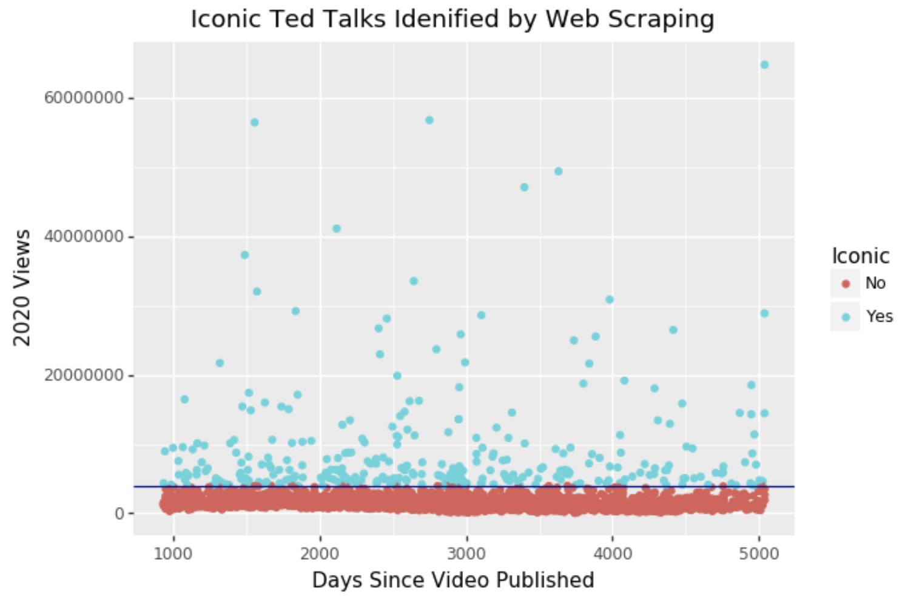
Defining Iconic Ted Talks
Obtained greater than 4 million lifetime views
Newly released videos were problematic
Solution: Scraped 2020 views for all the Ted Talks

Slide 5
Identifying Iconic Ted Talks
Talk Attributes
Topic Modeling
Part of Speech-Tagging
Named Entity Recognition
Sentiment Analysis

Slide 6
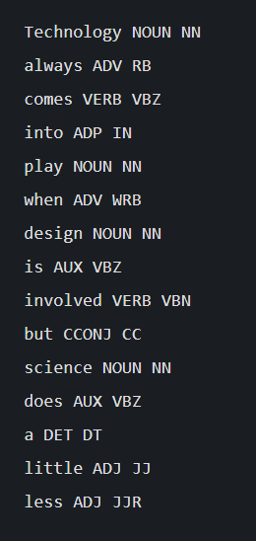
Part of Speech Tagging
Process of tagging a word in a text (corpus) to its corresponding part of speech, based on both its definition and its context i.e. relationship with the adjacent words
Part of Speech tags were extracted from each transcript:
NOUN': noun,
'VERB':verb,
'ADP': adposition,
'ADJ': adjective,
'DET': determiner,
'PROPN': proper noun,
'INTJ': interjection,
'NUM': numeral,
'PRON': pronoun,
'ADV': adverb,
'PART': particle and were included as features in the model
Topic Models were also created just using Nouns from each transcript

Slide 7
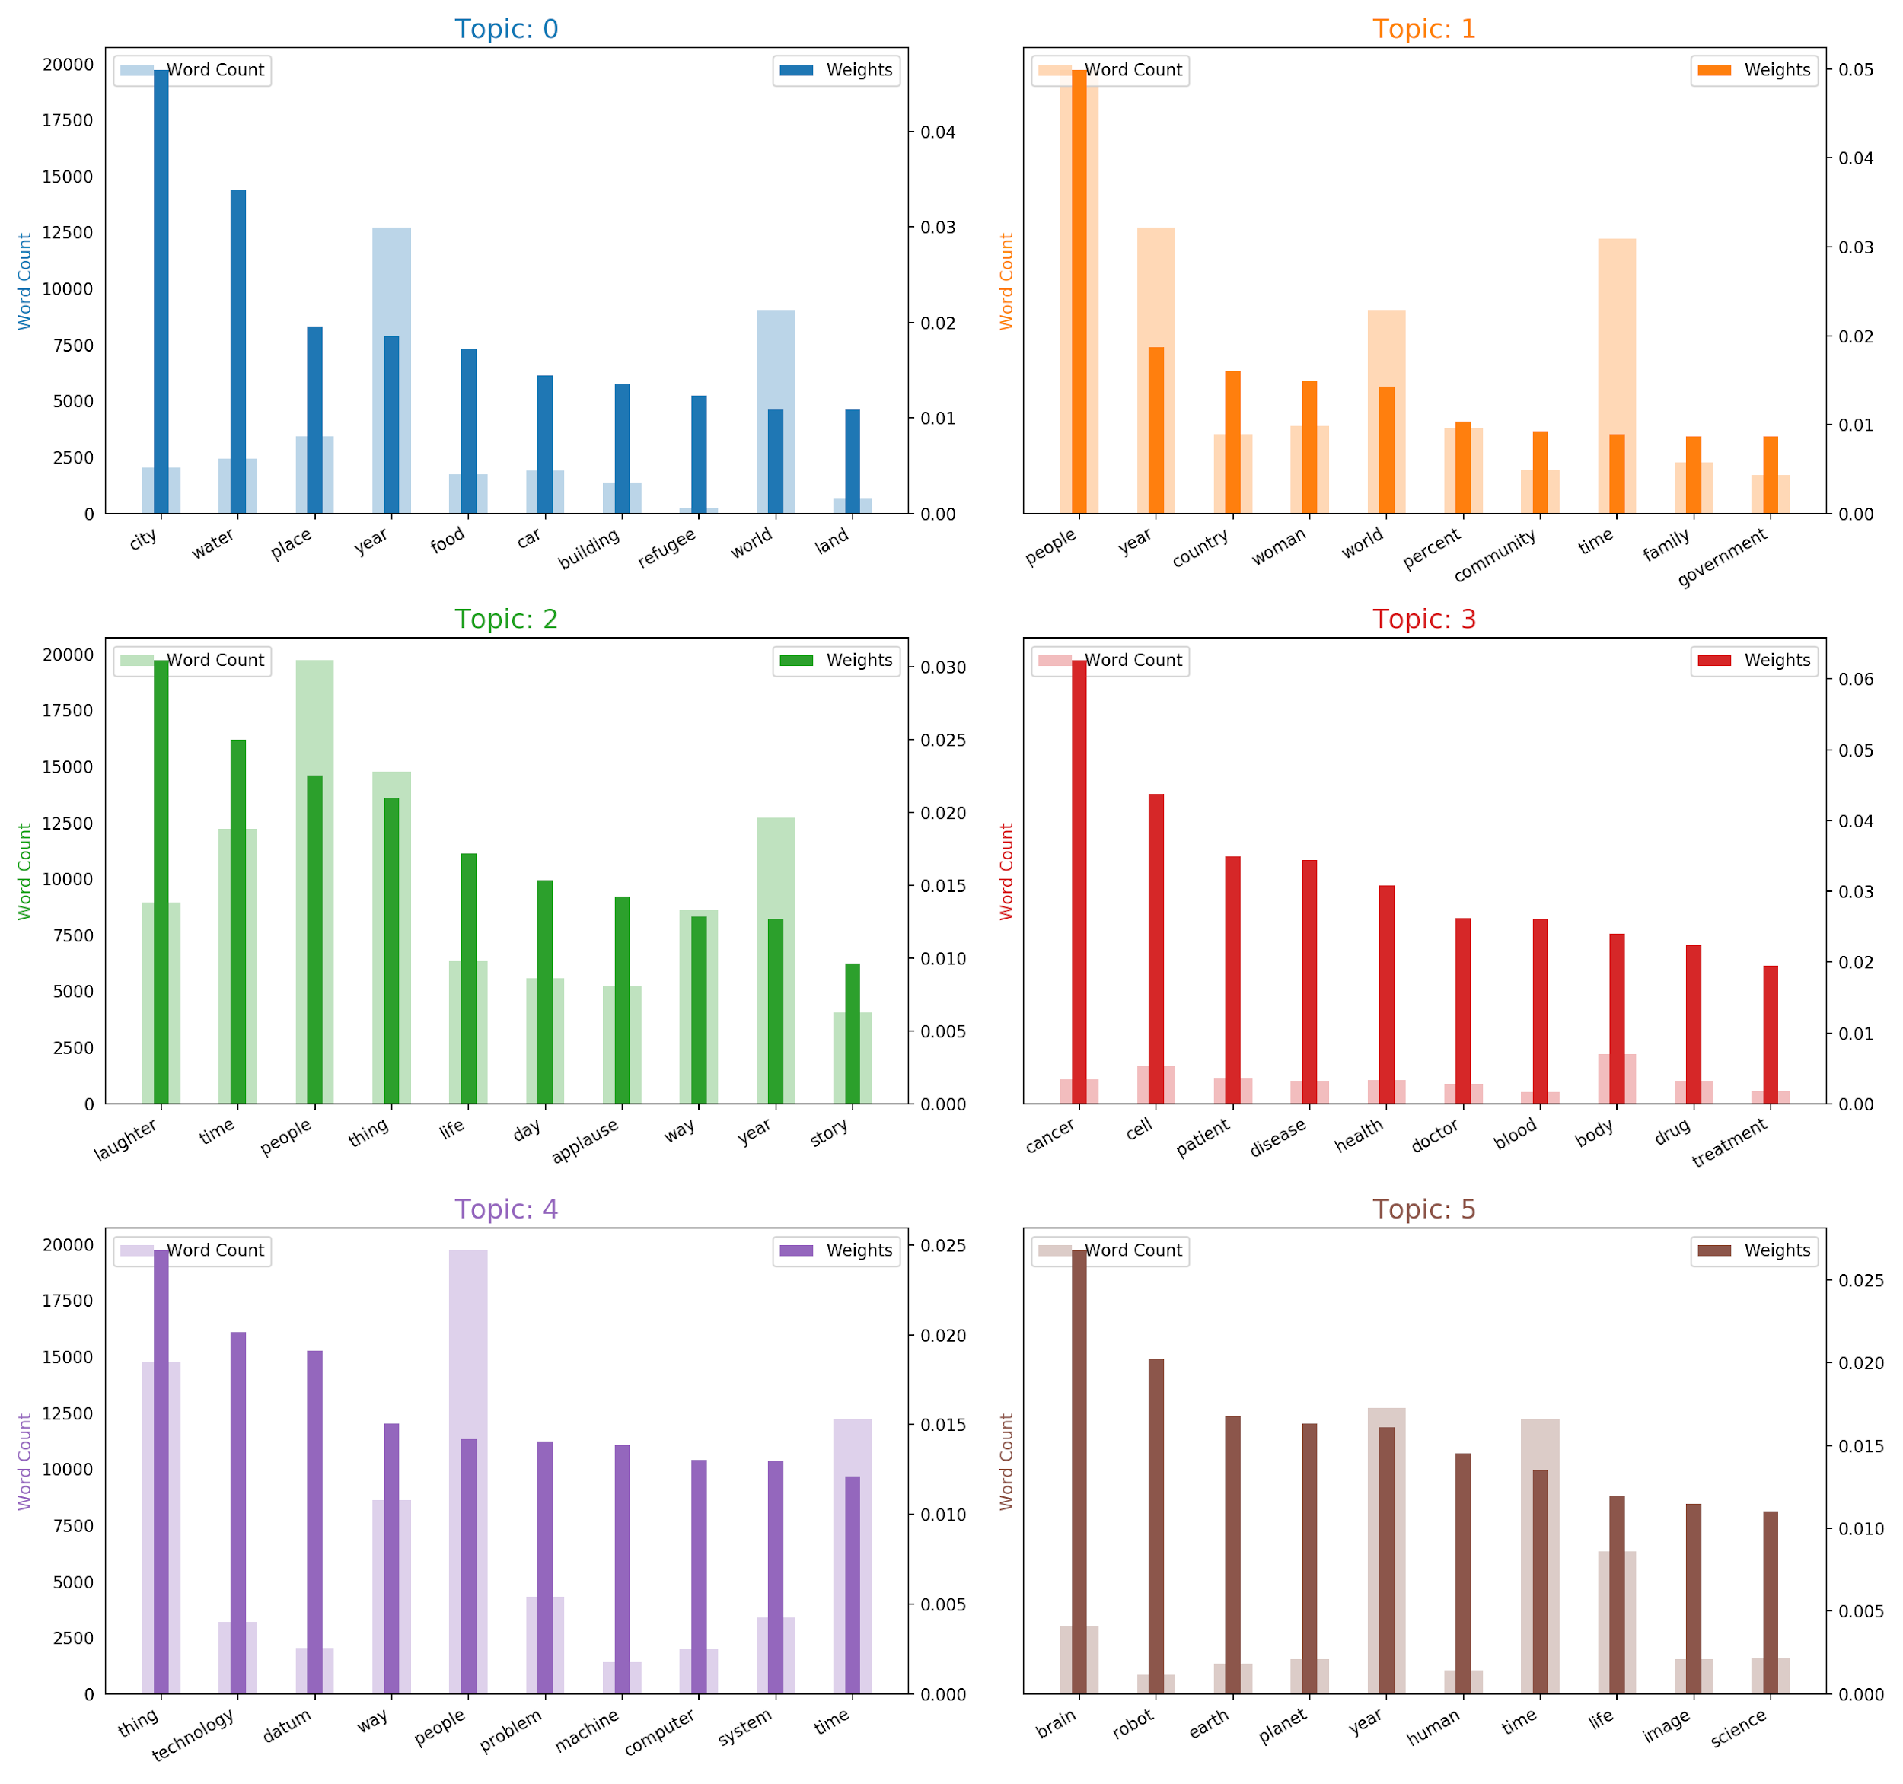
Topic Modelling
Used Nouns only
Topic Model with other parts of speech did not perform as well
Identified 6 Topics using LDA model

Slide 8
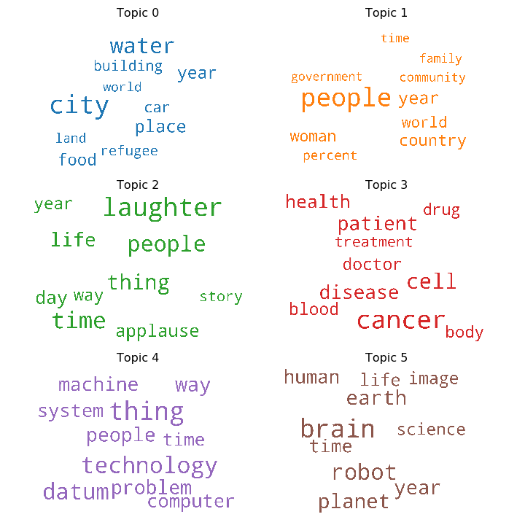
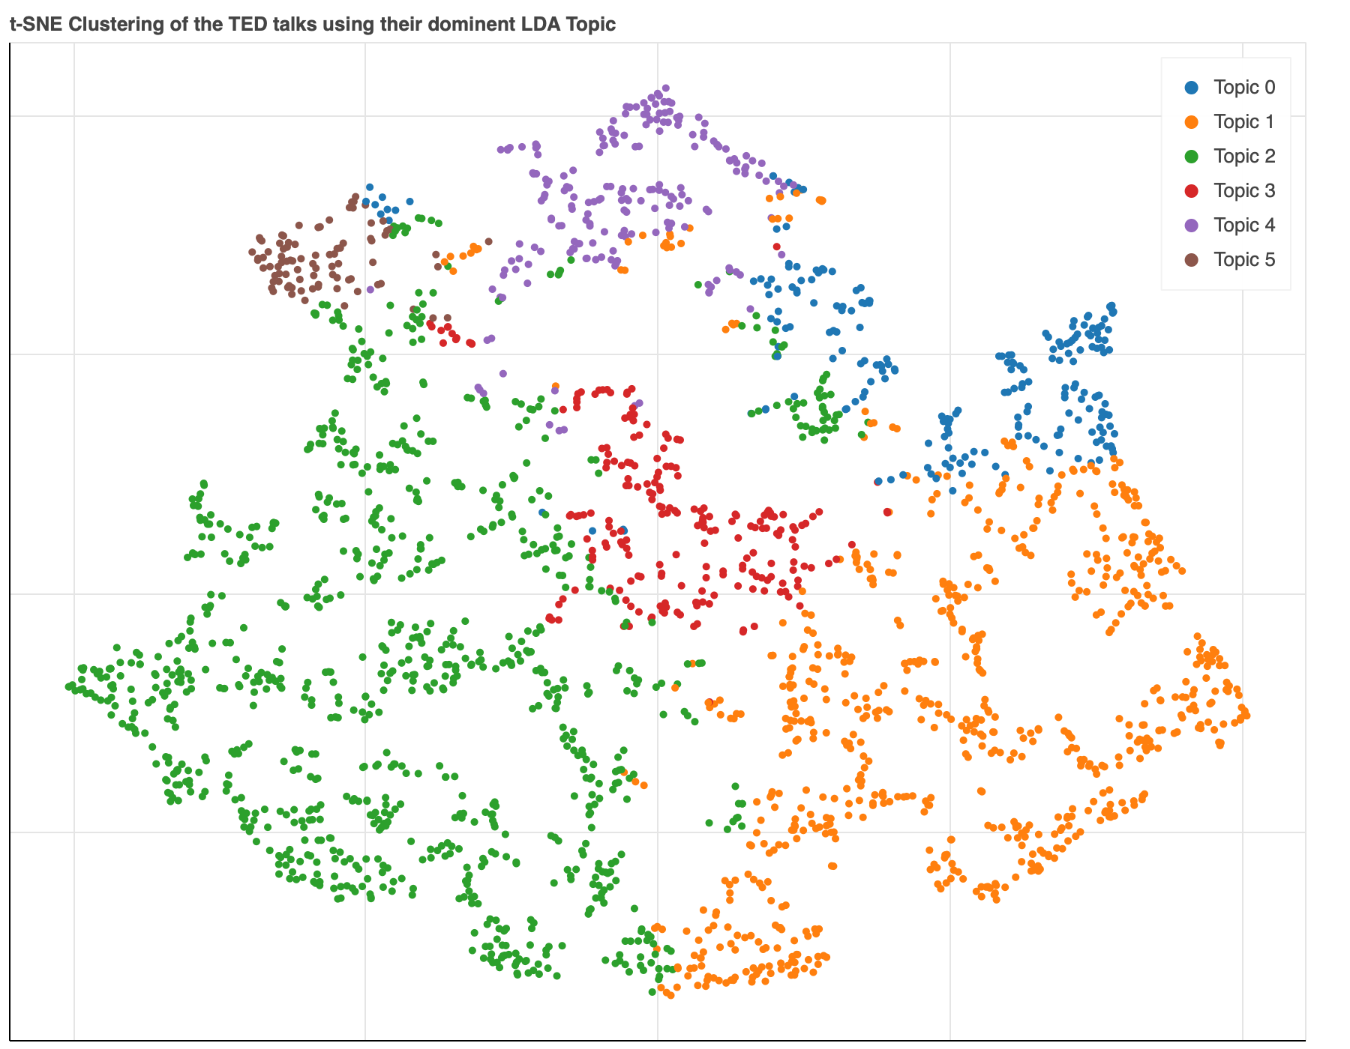
Topic Modelling

Slide 9
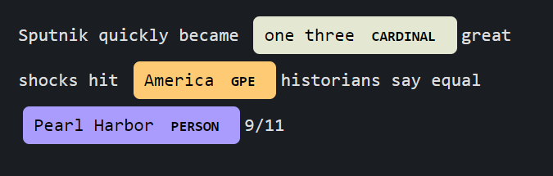
Named Entity Recognition
Information extraction technique that seeks to identify named entities in unstructured text and classifies them into predefined categories like names of people, organizations, locations or products among other things.
Example:
Countries, Cities, Places etc.

Slide 10
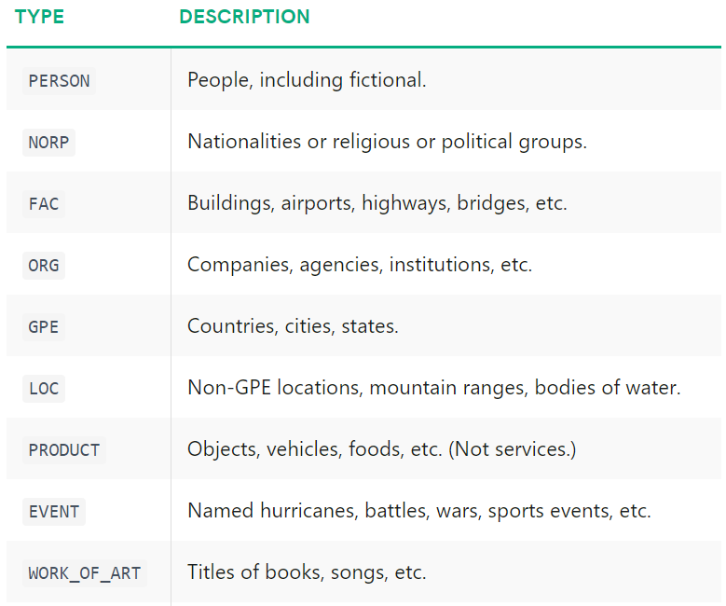
Named Entity Recognition
List of Entity types extracted from each transcript:
Source: https://spacy.io/api/annotation#section-named-entities

Slide 11
Predictive Models
Model 1
Model 2
Model 3
Features from Part of Speech Tagging + Named Entity Recognition
Test Predictive Accuracy:
Features from Part of Speech Tagging + Named Entity Recognition + Sentiment Scores of transcripts
Test Predictive Accuracy:
Features from Part of Speech Tagging + Named Entity Recognition + Topic Model
Test Predictive Accuracy:
87.60%
87.30%
89.12%

Slide 12
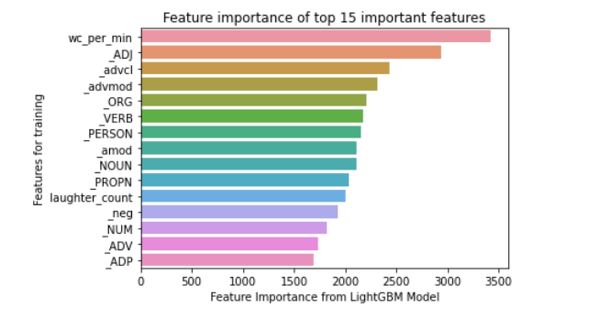
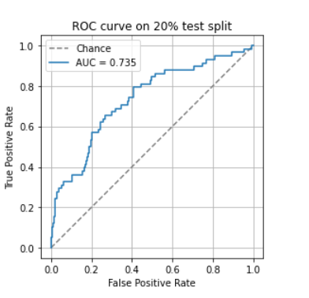
Final Model Results
Features Included:
Features from POS tagging,
Entity tags from Named Entity Recognition,
Binary tags for Dominant Topic identified for each transcript,
Word Count per minute,
Stopword count
Number of times the audience laughed or applauded during the talk

Slide 13
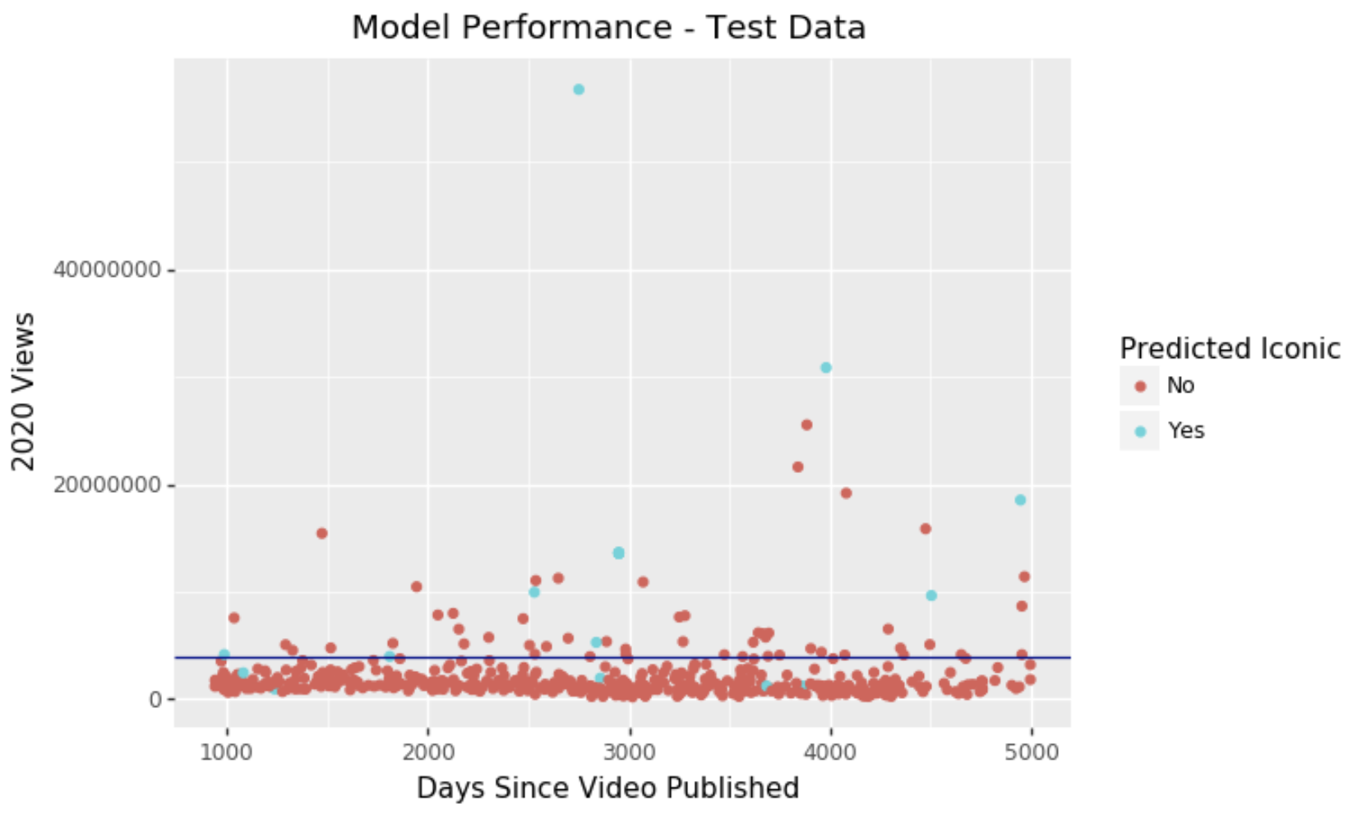
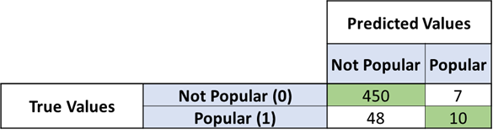
Model Performance - Test Data
Total Test Sample Size: 515
10 / 58 True Positives.
Only 7 False Positives!
450 / 457 True Negatives.

Slide 14
Transcript Generation

Slide 15
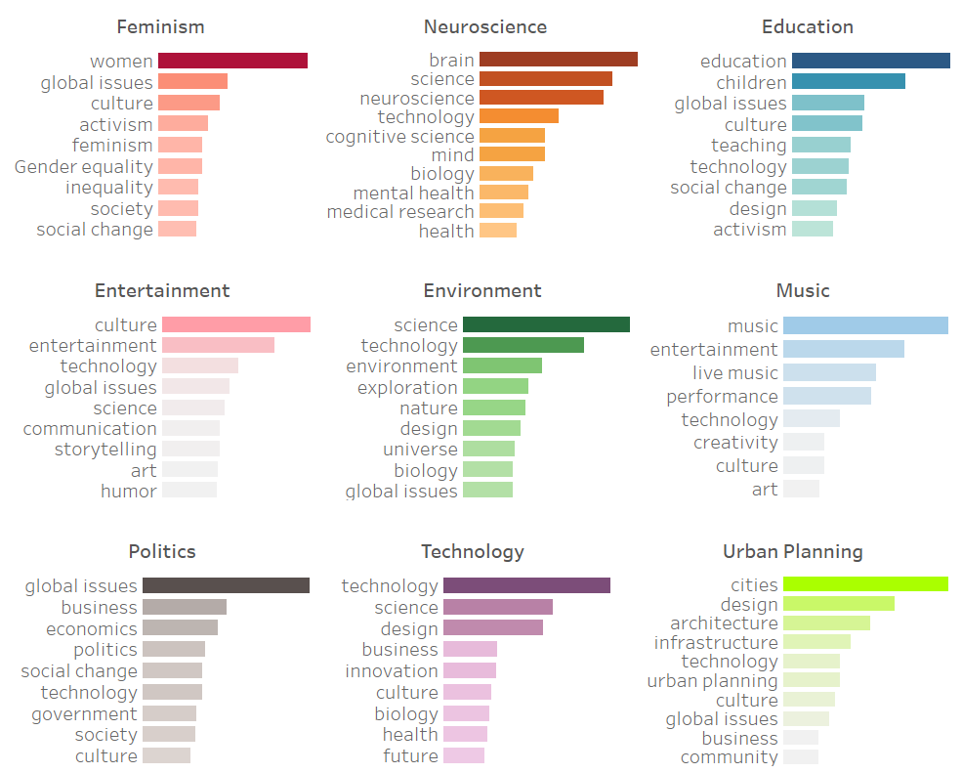
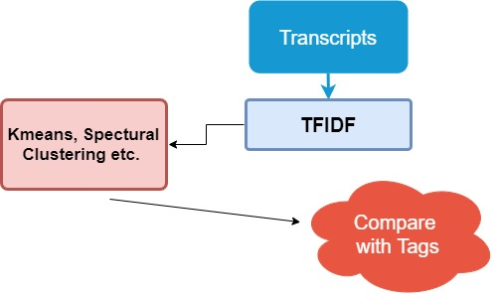
Clustering
Kmeans, Spectral Clustering, etc.

Slide 16
Text Generation (Char-based)
Network Architecture: Long short-term memory (LSTM, Hochreiter, 1997)
25 Most-viewed Ted Talks
25 Feminism Ted Talks
Improvements:
Char-based / Word-based Model
Network Architecture / Optimizer / Objective Function
More Training Data!
https://keras.io/examples/lstm_text_generation/

Slide 17
Future Work
Experiment with different Iconic Ted Talk Thresholds.
Include speaker attributes in predictive model.
Sentiment Analysis on the Ted Talk description and title.
Identifying celebrities to aid in predictive power.

Slide 18
ANY QUESTIONS?

